Slide 1
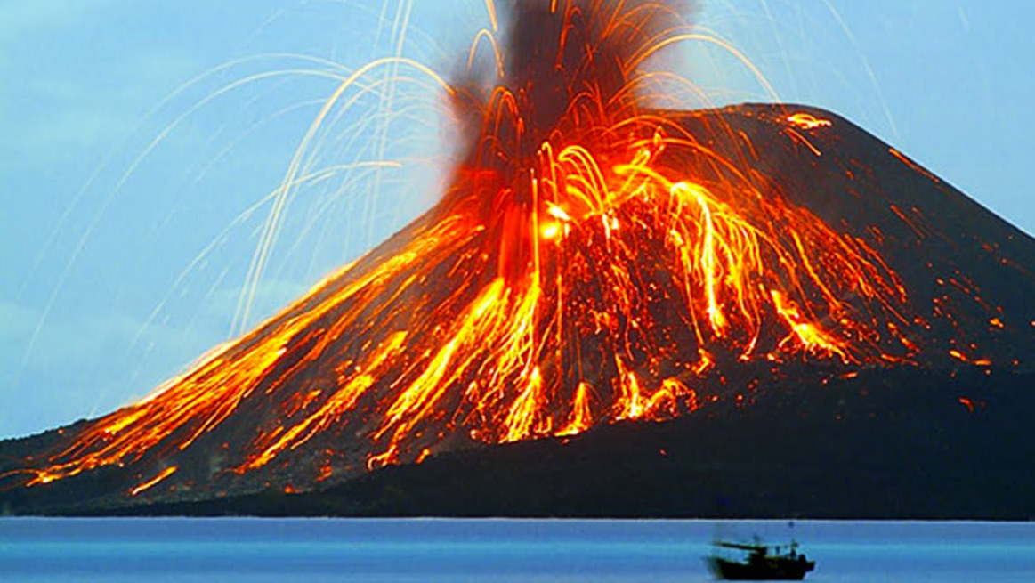
volcanos
By Matthew

Slide 2
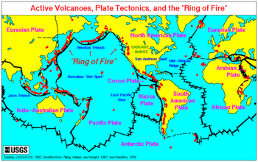
What is a volcano?
What causes a volcanic eruption?
A
Volcanos occur when hot, liquid rock , called lava seeps up from the earth’s mantle layer through cracks in the crust. Sometimes it oozes out quietly .But other times it explodes. Lava ,rocks ,and ash shoot upwards and when they cool and harden they form a cone or crater round the hole they have made .There are over 700 active volcanoes , which are situated along the earth’s fault lines. They are found underwater as well as on land , and about 20-30 erupt every year. There may be gaps of hundreds of years between eruptions , during which time volcanoes are termed dormant . When a volcano no longer erupts at all it is called extinct.

Slide 3
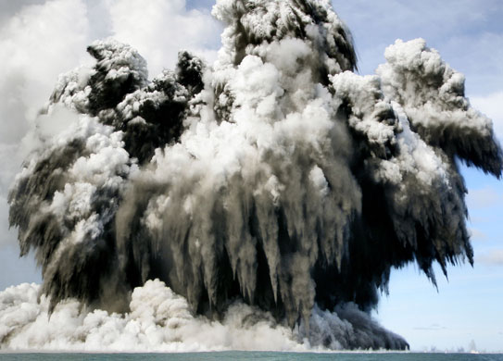
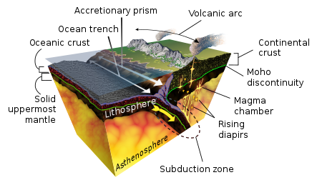
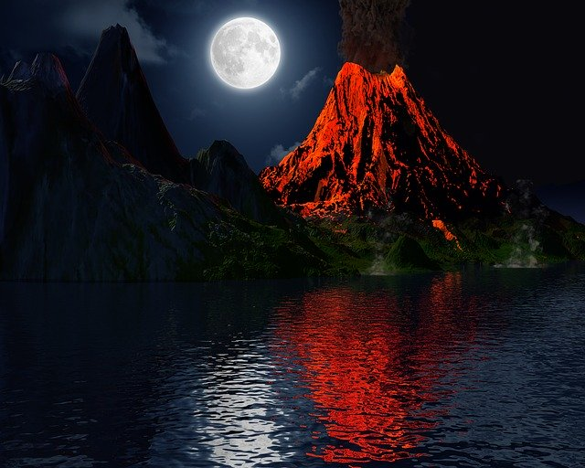
Undersea volcanoes
How do volcanic islands form
More volcanoes are found under the sea than on land because the oceanic crust is thinner than the continental crust. Volcanoes usually occur along the edges of the plates , but some are found in places where the mantle is so hot that it melts a hole in the thin crust above. These are called hotspots. Some of the islands in Hawaii , in the pacific ocean , were made by volcanoes forming over a hotspot and erupting under the sea.

Slide 4
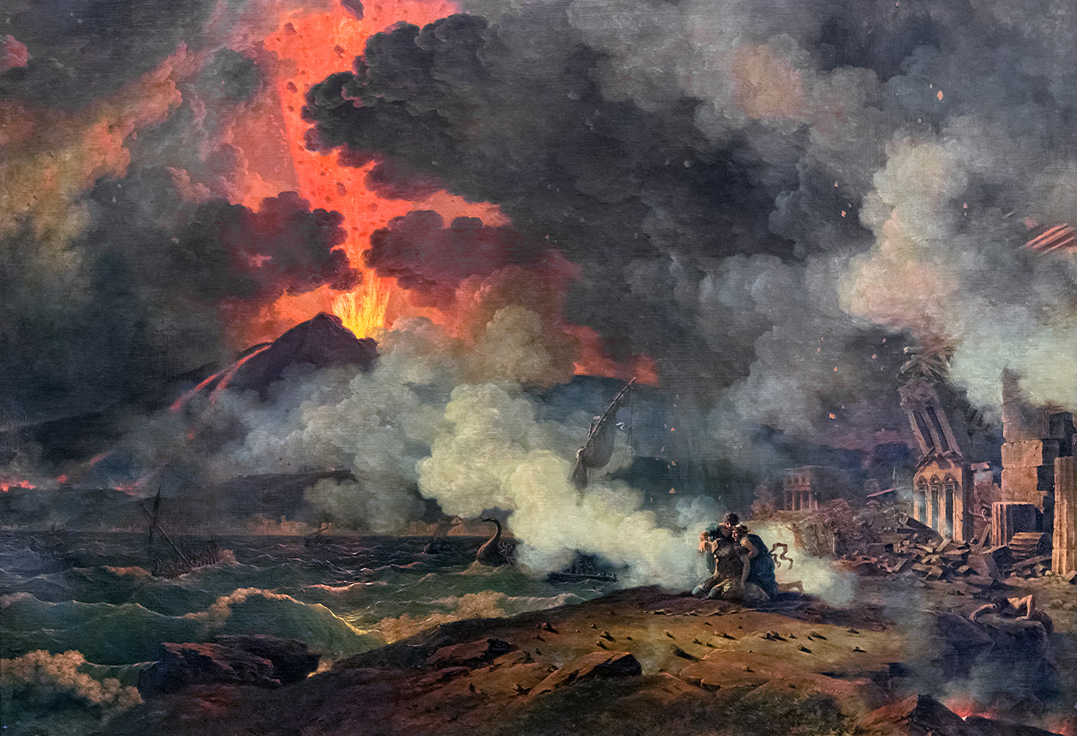
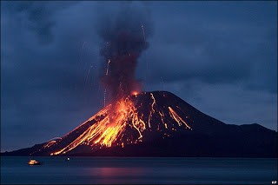
Famous volcanoes
Find out about Famous volcanos
AD79
Mount Vesuvius is another famous volcano because it buried the town of Pompeii.
1883
Krakatoa is one of the most famous of all the eruptions seeing as it blew it’s head off.
This Photo by Unknown Author is licensed under CC BY

